Slide 1

Welcome to
access.massbar.org
My Bar Access is the only online member-to-member community exclusive to Massachusetts Bar Association members.

Slide 2

What is My Bar Access?
Welcome to My Bar Access, the only online member-to-member community exclusive to Massachusetts Bar Association members.
A valuable new member benefit, My Bar Access combines social networking, member-created content and imperative bar resources, in one web location. As an MBA member, you can now instantly connect with fellow members of the legal community through blogs, online discussions (formerly known as listservs), resource libraries and more.

Slide 3
How to Use My Bar Access
This presentation will provide information on the following:
  How to interact: Creating your member profile and more (Slide 4)
  What type of user am I? Member vs. Group Admin (Slide 5)
  My Bar Access: The homepage (Slide 6)
  What are member groups? (Slide 10)
  How to contribute to My Bar Access: (Slide 17)
    Announcements (Slide 20);
    Blogs (Slide 26);
    Discussions (formerly known as listservs) (Slide 33); and
    Resource Libraries (recent shared files) (Slide 42).
NOTE: Each link in this presentation contains a return link to the original slide.

Slide 4
How Can I Interact?
Begin by creating your member profile and selecting your discussion settings
(Getting Started)
My Bar Access offers each Massachusetts Bar Association section or division an opportunity to interact and exchange information through member groups. In addition to member-created content, the member groups provide information on section-sponsored MBA On Demand programs, Section Review articles, section leadership and more.
Review this “How-To” to learn how you can use four interactive tools to interact with your fellow section/division members.
Return to the “How to Use My Bar Access” slide

Slide 5





What Type of User Am I?
Am I a Member or a Group Admin?
Member:
If you are a current member of the Massachusetts Bar Association, you can start contributing to your
My Bar Access member group(s) by creating your user profile. You can then utilize interactive tools
to communicate with your fellow section/division members, including: accessing/creating blogs
and discussion posts and adding files to the resource library . In addition, group-specific
announcements , MBA On Demand programs, Section Review articles and more are available.
    NOTE: Click the symbols on these slides throughout this “How-To” for information on how to use the above interactive tools to communicate with your fellow section/division members.
Group Admin: (Click here for the role of Group Admins)
Group Admins are appointed by section leadership. Group Admins manage their section’s
member-generated content by adding group announcements, encouraging fellow group members to
post and modifying member group tags. The symbol in these slides will point out the specific
abilities and/or functions of a Group Admin.
Return to the following slides:
“How to Use My Bar Access”
“Announcements”
“How to Contribute”
“How to Contribute: Member-Created Content Explained”
“How to Access your Member Group’s Landing Page: Member-Created Content Displayed”
NOTE: Clicking on each symbol will navigate you to the slide for that interactive tool.

Slide 6
My Bar Access:
The Homepage
Return to the “How to Use My Bar Access” slide

Slide 7
The Homepage
My Bar Access is specific to you as a user -- the My Bar Access homepage displays member-created content from each member group you are a part of, such as blog and discussion posts.
From your homepage, you can customize your discussion subscription options and privacy settings to decide how you wish to interact with fellow section/division members and receive group updates.
On the homepage, the Your Groups column provides information from your member groups, In the Know informs you what’s happening around the MBA and the MBA Resources column includes details on the latest On Demand programs, practice tips and more.
Navigate to access.massbar.org and click , in the upper right hand corner, to login to My Bar Access.
NOTE: You may click the links above to navigate to the My Bar Access homepage.

Slide 8
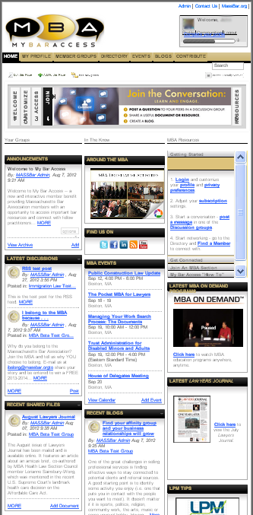
The Homepage
When you login to My Bar Access (login here) you will arrive at a screen that looks similar to this one:
Customize your profile here.
Learn about My Bar Access
Click the WELCOME slide and then CUSTOMIZE your experience to join the CONVERSATION, and to ACCESS and utilize MBA RESOURCES here.
Navigation Bar
Access the MY PROFILE, MEMBER GROUPS, DIRECTORY, EVENTS, BLOGS, CONTRIBUTE and RESOURCE CENTER drop-down menus here.
Find the Getting Started, My Bar Access site Glossary and other instructional documents here.
Your Groups, In the Know and MBA Resources columns are displayed here.
View upcoming MBA Events here. You can choose either “list” view (as displayed here) or click “View Calendar” to show events in a traditional calendar format.
The most recent member-created content from your group(s) is displayed in Latest Discussions, Recent Shared Files (Resource Library entries) and Recent Blogs. (See next slide for more details.)
Access the Latest MBA On Demand programs, Lawyers Journal and LPM Tips here.
NOTE: Click the “Contact Us” link in the upper right hand corner of the homepage for questions regarding My Bar Access.

Slide 9
The Homepage
Here’s how your group(s) member-created content is displayed on your user-specific homepage:
Announcements
Member group specific. Group Admins can utilize announcements to post information about events, legal news or other group‐specific information.
Discussions
Every member group has its own discussion functionality -- a way for members to instantly connect via web-enriched e-mail messaging. Discussions allow users to interact with fellow practitioners and utilize colleagues as resources.
Recent Shared Files
The Resource Library allows users to share files, including multimedia, in a socially-enriched environment. All discussion attachments are automatically contributed to the resource library.
Recent Blogs
Recent blog posts are displayed here. Every member group has an interactive blog option, providing members with an opportunity to post opinions about recent legal decisions, personal experiences in the courtroom, practice tip ideas and more. Each blog poster can choose who sees his/her post and who can make comments on the blog posting.
Return to the “How to Contribute” slide
NOTE: Click each symbol for more information on member-created content.

Slide 10
Member Groups
Return to the “How to Use My Bar Access” slide

Slide 11
Member Groups
My Bar Access offers each Massachusetts Bar Association section or division an opportunity to interact and exchange information through member groups. In addition to member-created content, the member groups provide information on events, section-sponsored MBA On Demand programs, Section Review articles, section leadership and more.

Slide 12
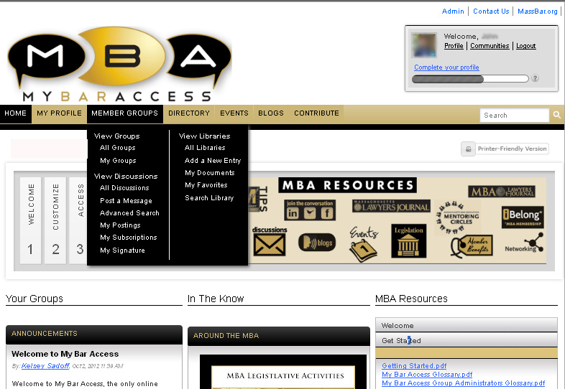
How to Access Your Member Group(s)
You can access your member group(s) from your homepage by hovering your cursor over MEMBER GROUPS in the navigation bar and selecting “View Groups” > “All Groups” from the drop-down menu:
NOTE: Click the “Contact Us” for any questions regarding My Bar Access.

Slide 13
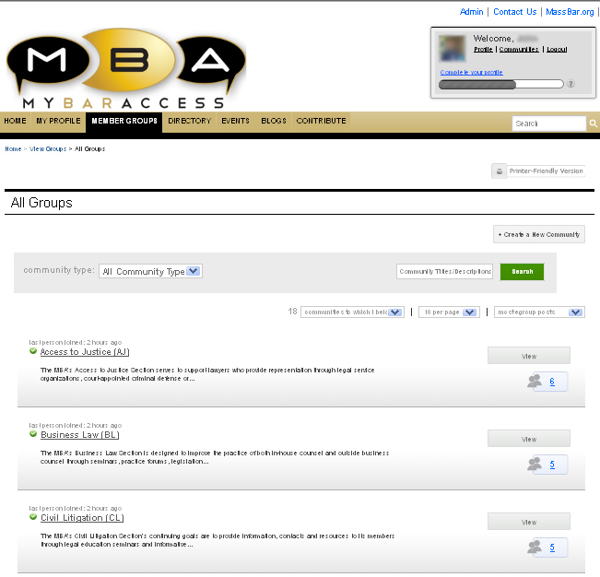
How to Access Your Member Group(s)
Clicking the “All Groups” option in the drop-down menu will display a screen listing all the member groups you belong to (aka all the MBA section/division(s) you are a member of):
Interested in joining a section? Click here.
For example, this user is a member of the Access to Justice, Business Law and Civil Litigation member groups.

Slide 14
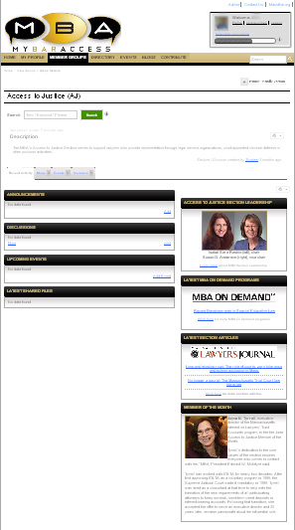
How to Access Your Member Group’s Landing Page
Click the name of the member group to visit that section’s landing page.
For example, if you’re a member of Access to Justice and click that member group’s name, this page will be displayed:
Navigation Bar
Access the MY PROFILE, MEMBER GROUPS, DIRECTORY, EVENTS, BLOGS and CONTRIBUTE drop-down menus here.
Your member group’s name and description will be found here.
The Dashboard
These tabs allow you to navigate between the Recent Activity, Blogs, Events and Members portions of your member group. (See next slide for more details.)
Learn more about your member group’s Section Leadership, access the Latest MBA On Demand programs, Section Review articles and the Member of the Month here.

Slide 15
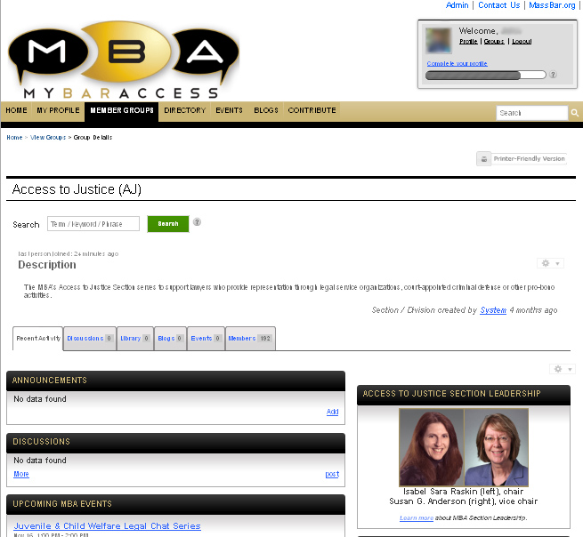

How to Access Your Member Group’s Landing Page
The landing page’s dashboard is displayed as seen here:
Navigating to your member group’s landing page will display the Recent Activity tab by default.
Click the Events tab to view upcoming events for your member group.
The Library tab will guide you to your member group’s resource library.
Click the Discussions tab to view discussions for your member group.
Click here to view your member group’s blog entries.
Click the Members tab to view the current members of your member group and to add contacts.
Dashboard

Slide 16
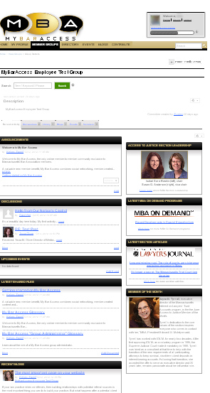
How to Access Your Member Group’s Landing Page
The landing page also displays member-created content:
Announcements
See the latest events, legal news or other group-specific information here.
Group Admins can also post new announcements here.
Discussions
View recent discussion posts. Click “more” for archived posts and to create new discussions here.
Latest Shared Files
The resource library allows users to share files, including multimedia, in a socially-enriched environment. All discussion attachments are automatically contributed to the resource library.
Recent Blogs
Recent blog posts are viewed and accessed here.
NOTE: Click each symbol for more information on member-created content.
Return to the “How to Contribute” slide

Slide 17
How to Contribute
Return to the following slides:
“How to Use My Bar Access”
“What Type of User Am I?”
NOTE: You can contribute to every member group to which you belong. All sections are free with this year’s new membership dues structure.

Slide 18
How to Contribute
My Bar Access provides an opportunity to interact and exchange information through member-created content in section/division-specific member groups.
My Bar Access members can view announcements , create blogs and discussions and add to the resource library from the My Bar Access homepage as seen here, or through your member group’s landing page as shown here. NOTE: Most member-created content will be searchable by the public.
Additionally, Group Admins can post announcements from both the My Bar Access homepage as seen here, as well as the landing page of the member group they manage as seen here.
The remaining slides will detail how to contribute to My Bar Access using the announcements , blogs , discussion and resource library tools.
Return to the following slides:
“What Type of User Am I?”
“How to Add Announcements . . . Homepage”
“How to Add Announcements . . . Landing Page”

Slide 19
How to Contribute
My Bar Access allows you to interact with fellow members via these tools:
Announcements
Announcements are My Bar Access member group specific. ONLY Group Admins can utilize announcements to post information about events, legal news or other group-specific information.
Blogs
Every My Bar Access member group has an interactive blog option, providing members with an opportunity to post opinions about recent legal decisions, personal experiences in the courtroom, practice tip ideas and more. Each blog poster can choose who sees his/her post and who can make comments on the blog posting.
Discussions (formerly known as listservs)
Every My Bar Access group has its own discussion functionality -- a way for members to instantly connect via web-enriched e-mail messaging. Discussions allow users to interact with fellow practitioners and utilize colleagues as resources.
Resource Library (Recent/Latest Shared Files)
Allows users to share files, including multimedia, in a socially-enriched environment. All discussions maintain a library, which contains discussion post attachments.
NOTE: Clicking on each symbol will navigate you to the slide for that interactive tool.

Slide 20
Announcements
Return to the following slides:
“How to Use My Bar Access”
“What Type of User Am I?”
“Homepage: Member-Created Content Displayed”
“How to Access your Member Group’s Landing Page: Member-Created Content Displayed”
“How to Contribute”
“How to Contribute: Member-Created Content Explained”

Slide 21
Announcements
Announcements are My Bar Access member group specific.
The announcements are displayed on your My Bar Access homepage as seen here, as well as your member group’s landing page as displayed here.
As previously explained, ONLY appointed Group Admins can utilize the announcements tool to post information about events, legal news or other group-specific information. Group Admins can post information from both the My Bar Access homepage as seen here, as well as the landing page of the member group they manage as seen here.
The following four slides will detail how to contribute to My Bar Access using announcements.

Slide 22
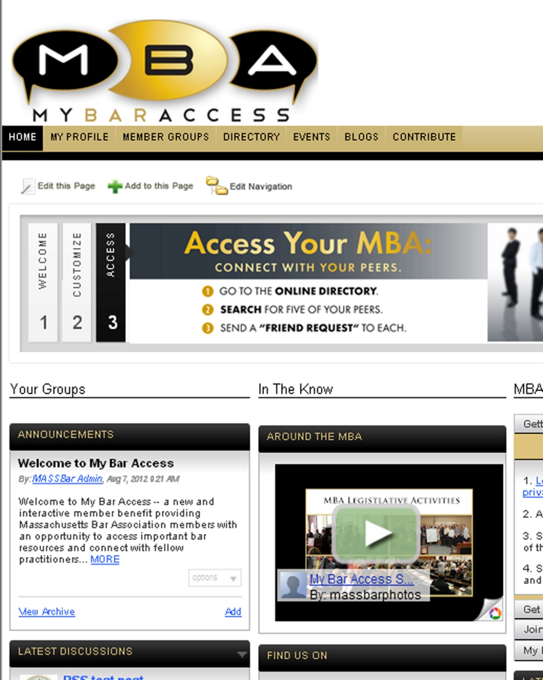
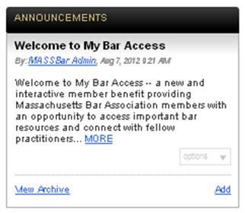
How to View the Announcements from Your My Bar Access Homepage
Header for content item
Title of announcement
Poster, date and time of post
Click the screen to find out about announcements
Announcement text
Read “more” Link
Options (Management) Links:
ONLY seen by Group Admins. Click to
“edit” and/or “delete” announcement.
Click to view previous announcements.
For Group Admins:
Click to “add” a new announcement

Slide 23
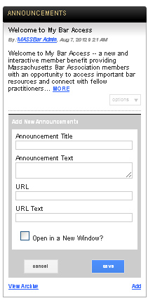
How to Add Announcements from Your My Bar Access Homepage
(Group Admins ONLY)
Clicking “add” in the announcements will display this page:
Announcement box
Users: Click here to skip this slide.
Group Admins:
Click the screen to find out how to “add” an announcement from the homepage.
Insert title for new announcement.
Insert text for new announcement.
Insert URL link.
Check this box if you would like to display the announcement in a new window.
Insert text for URL link.
Click here to “cancel” your announcement post.
Click here to “save” your announcement.
Return to the following slides:
“How to Contribute”
“Announcements”

Slide 24
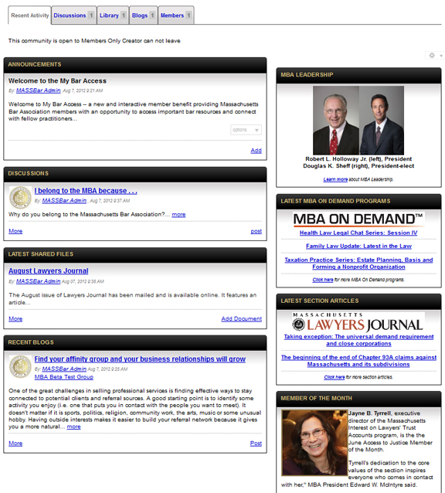
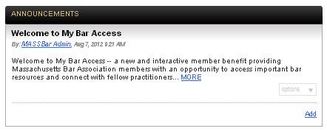
How to View Announcements from Your Member Group’s Landing Page
Announcements can also be accessed from your member group’s landing page:
Dashboard
Header for
content item
Title of announcement
Poster, date and time of post
Click the screen to find out about announcements
Announcement text
Group Admins
Click to “add” a new announcement.
Read “more” link
Options (Management) Links: ONLY seen by Group Admins.
Click to “edit” and/or “delete” announcement.

Slide 25
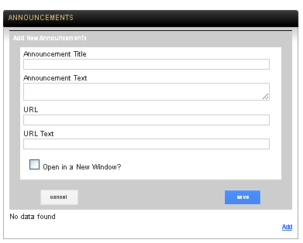
How to Add Announcements from Your My Bar Access Landing Page
(Group Admins ONLY)
Clicking “add” in the announcements will display this page:
Dashboard
Header for
content item
Group Admins:
Click the screen to find out how to “add” an announcement from the landing page.
Users: Click here to skip this slide.
Insert title for new announcement.
Insert text for new announcement.
Insert URL link.
Check this box if you would like to display the announcement in a new window.
Insert text for URL link
Click here to “save” your announcement.
Click here to “cancel” your new announcement post.
Return to the following slides:
“Homepage: Member-Created Content Displayed”
“How to Access your Member Group’s Landing Page: Member-Created Content Displayed”
“How to Contribute”
“Announcements”
“How to View the Announcements . . . Homepage”
“How to View the Announcements . . . Landing Page”

Slide 26
Blogs
Return to the following slides:
“How to Use My Bar Access”
“What Type of User Am I?”
“The Homepage”
“The Homepage: Member-Created Content Displayed”
“How to Access your Member Group’s Landing Page: Member-Created Content Displayed”
“How Contribute”
“How to Contribute: Member-Created Content Explained”

Slide 27
Blogs
Every member group has an interactive blog option, providing members with an opportunity to post opinions about recent legal decisions, personal experiences in the courtroom, practice tip ideas and more.
Each blog poster can choose who sees his/her post and who can make comments on the blog posting. A poster can even use spell check when commenting on a blog post.
The blogs are displayed on your My Bar Access homepage as seen here, as well as on your member group’s landing page as seen here..
The following five slides will detail how to contribute to My Bar Access using blogs.
NOTE: Click the blog symbol to navigate between slides.

Slide 28
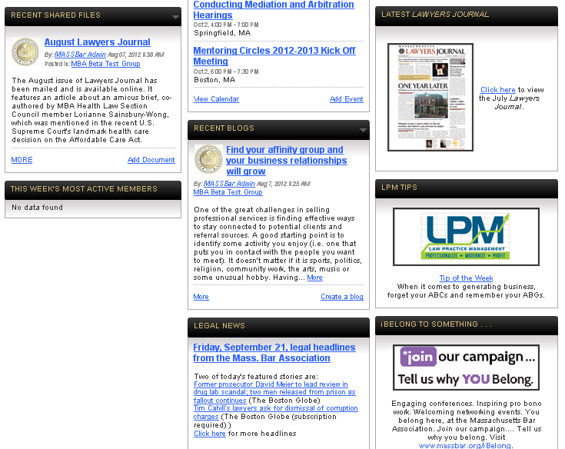
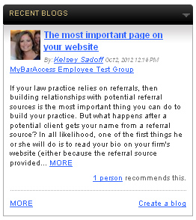
How to Access the Recent Blogs from Your My Bar Access Homepage
Header for content item
More Options -- Click to “show most rated.”
Title of blog post
Poster, date and time of post
Click the screen to find out about
recent blogs
Blog text
Read “more” link
Click to view previous blog postings.
Click to “create” a new blog posting.

Slide 29
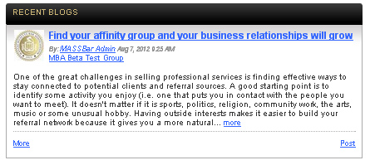
How to Access the Recent Blogs from Your Member Group’s Landing Page
Blogs can also be accessed from your member group’s landing page:
Dashboard
Header for
content item
Click the screen to find out about
recent blogs
Poster, date and time of post
Title of Blog
Blog text
Read “more” link
Click to see “more” blogs postings.
Click to create a new blog “post”

Slide 30
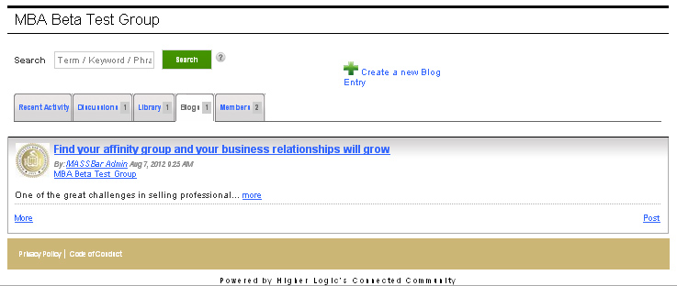
How to Access the Recent Blogs from Your Member Group’s Landing Page
Blogs can also be accessed by utilizing the dashboard of your member group’s landing page:
Enter text to search archived blogs.
Click here to “create a new blog entry.”
Dashboard
Title of blog
Poster, date and time of post
Click to access archived blog posts.
Read “more” link
Click here to “post” a new blog.

Slide 31

How to Create a Blog
My Bar Access homepage vs. your member group’s landing page
  Homepage -- Creating a blog:
    Click the “Post” link in the recent blogs toolbox
            or
    Navigating to the blog tab on the dashboard of your member group’s landing page and clicking the link which appears above the dashboard
  Landing page -- Creating a blog:
    Click the “Create a blog” link in the blogs toolbox
            or
    Select “Create New Blog” from the drop down menu under BLOGS in the navigation bar

Slide 32
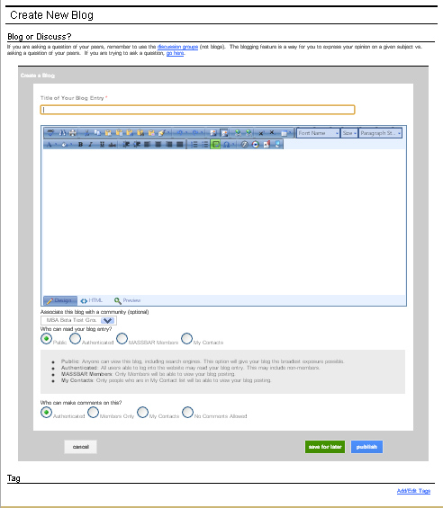
How to Create a Blog
Clicking on the “post” or any “create a blog” link from either your My Bar Access homepage or your member group’s landing page will navigate you to this screen:
Are you creating a blog or discussion?
Editing toolbars
Review spelling & grammar, adjust font settings, insert hyperlinks, copy & paste and more.
Insert the title of your blog entry.
Insert the content of your blog.
Click the screen to find out how to create a blog
Select the member group you wish to associate with your blog. (optional)
Select who you want to read your blog.
Select who can comment on your blog.
Click to “cancel” your blog entry.
Click to “add/edit tag(s)” to your blog.
1
32
“save for later” and “publish” buttons

Slide 33
Discussions
Return to the following slides:
“How to Use My Bar Access”
“What Type of User Am I?”
“The Homepage”
“The Homepage: Member-Created Content Displayed”
“How to Access your Member Group’s Landing Page: Member-Created Content Displayed”
“How Contribute”
“How to Contribute: Member-Created Content Explained”
“Resource Library“

Slide 34
Discussions (formerly known as listservs)
Every My Bar Access member group has its own discussion functionality -- a way for members to instantly connect via web-enriched e-mail messaging.
Discussions allow users to interact with fellow members of the bar and utilize colleagues as a resource.
A discussion poster can share his or her discussion question/post with any My Bar Access member groups to which he or she belongs. A poster can even use spell check when commenting on discussions located in the editing toolbar when posting a discussion.
All attachments include in a discussion post are automatically added to the associated member group’s resource library .
All discussion posts are available at My Bar Access and are searchable by the public.
The latest discussions are displayed on your My Bar Access homepage as seen here, as well as your member group’s landing page as seen here.
The following seven slides will detail how to contribute to My Bar Access using discussions.

Slide 35
Discussions (formerly known as listservs)
When you set up your “My Subscriptions” portion of your My Bar Access profile, you can choose how often you wish to receive discussion posts. Options include:
  Real-time: You receive an e-mail for each post made in your member groups. You must login to My Bar Access to respond to the discussion thread.
  Daily Digest (recommended): You receive a single e-mail each day which includes every post to the discussion group for the previous day. Daily digests for multiple groups cannot be compiled. You must login to My Bar Access to respond to the discussion thread.
    For example, if you are a member of the My Bar Access Young Lawyers Division and the Access to Justice groups -- you will receive a digest for each group.
  Legacy (most like a traditional listserv): You receive a message for every post in real-time. The Legacy options are plain text format (no HTML) and allow the subscriber to respond to a message, or create one, from an e-mail client as opposed to being logged into My Bar Access. This option does not allow attachments.
  No E-mails (Opting out of e-mail delivery. Not recommended): You will have to login to My Bar Access every time, to view discussion posts. You must login to My Bar Access to respond to the discussion thread.

Slide 36
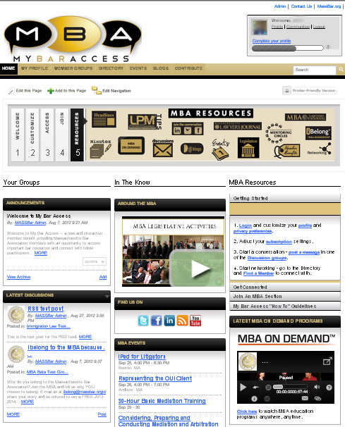
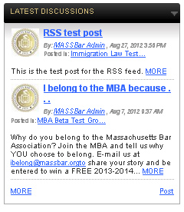
How to Access the Discussions from Your My Bar Access Homepage
Header for content item
More Options -- Click to “show most rated.”
Titles of latest discussions
Poster, date and time of post
Click the screen to find out about
discussions
Read “more” links
Discussion text
Click to view previous discussions.
Click to “post” a new discussion.

Slide 37
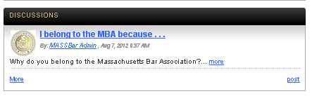
How to Access the Discussions from Your Member Group’s Landing Page
Discussions can also be accessed from your member group’s landing page:
Dashboard
Header for content item
Title of discussion
Click the screen to find out about discussions
Poster, date and time of post
Discussion text
Read “more” link
Click to view previous discussions.
Click to “post” a new discussion.

Slide 38
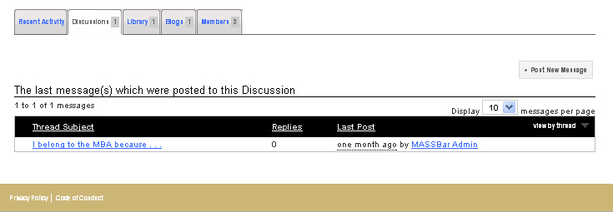
How to Access the Discussions from Your Member Group’s Landing Page
Discussions can also be accessed by utilizing the dashboard of your member group’s landing page:
Dashboard
Click to post a new message.
Viewing options
Click arrow to “sort by most recent.”
Click here to view and access the discussion post.
Reply to this post by clicking here.

Slide 39
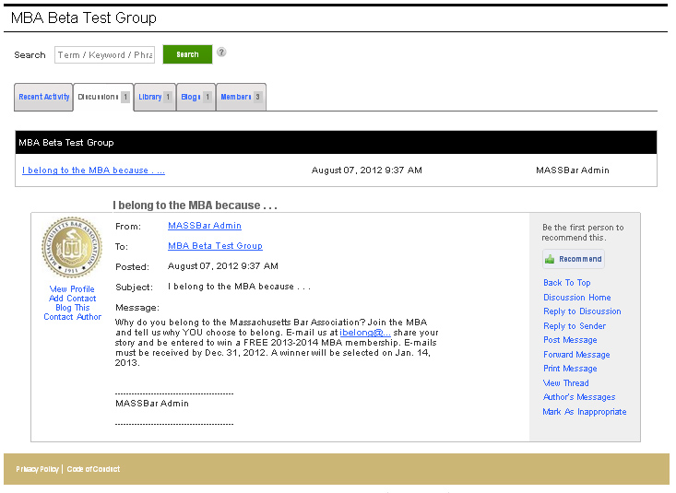
How to Access the Discussions from Your Member Group’s Landing Page
Clicking on any discussion post will display this page:
Enter text to search discussion posts
Dashboard
Title of discussion
Discussion poster information
Posting
information
Recommend this discussion
Discussion text
Discussion options
NOTE: Click “Reply to Discussion” to respond to the entire discussion thread or “Reply to Sender” to respond only to the poster.

Slide 40

How to Post a New Discussion
My Bar Access homepage vs. my member group’s landing page
  Homepage -- Posting a discussion:
    Click the Post link in the latest discussions toolbox
    or
    Select “Post a Message” from the drop-down menu under MEMBER GROUPS in the navigation bar
  Landing page -- Posting a discussion:
    Click the “Post” link in the discussions toolbox
            or
    Navigate to the discussions tab on the dashboard of your member group’s landing page and clicking the link which appears above the dashboard
            or
    Click the “Post Message” link in any discussion posting

Slide 41
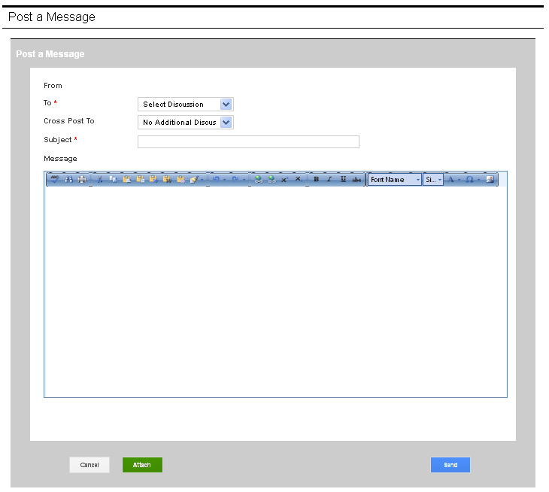
How to Post a new Discussion
Clicking on the “post” or any “post message” link from either your My Bar Access homepage or your member group’s landing page will navigate you to this screen:
Name of poster
Select where you want to post your discussion.
Select where you would like to cross post your discussion . (optional)
Subject of your discussion
Click the screen to find out how to post a new discussion
Editing toolbar:
Review spelling & grammar, adjust font settings, insert hyperlinks, copy & paste and more.
Insert the content of your discussion.
Click to “cancel” your discussion post.
Click to “send” your discussion.
Click to “attach” a document to add to the resource library.

Slide 42
Resource Library
Return to the following slides:
“How to Use My Bar Access”
“What Type of User Am I?”
“The Homepage: Member-Created Content Displayed”
“How to Access your Member Group’s Landing Page: Member-Created Content Displayed”
“How Contribute”
“How to Contribute: Member-Created Content Explained”
“Discussions”

Slide 43
Resource Library
Also referred to as Recent Shared Files or Latest Shared Files, the resource library allows users to share files, including multimedia, in a socially-enriched environment.
Group Admins perform core management roles within the library including: library file editing and deletion, approving flagged library entries, reassigning library entries and organizing the library folder view.
Discussion attachments are automatically add to the associated member group’s resource library.
The latest resource library entries are displayed on your My Bar Access homepage as seen here as well as your member group’s landing page as seen here.
All resource library entries are available at My Bar Access and are searchable by the public.
The following seven slides will detail how to contribute to My Bar Access using the resource library.

Slide 44
How to Access the Resource Library
  Homepage -- Adding a resource library entry:
    Click the link in the recent shared files toolbox
  Landing page -- Adding a resource library entry:
    Click the link in the latest shared files toolbox
            or
    Selecting “Library” tab, clicking “Switch to Folder View” and clicking
    under the Folder Contents column
NOTE: Clicking each of the links above will navigate you to the slide showing where that link is displayed on the homepage and landing page.
The remaining slides will go through each method, in detail, and explain how to add files to the resource library.

Slide 45
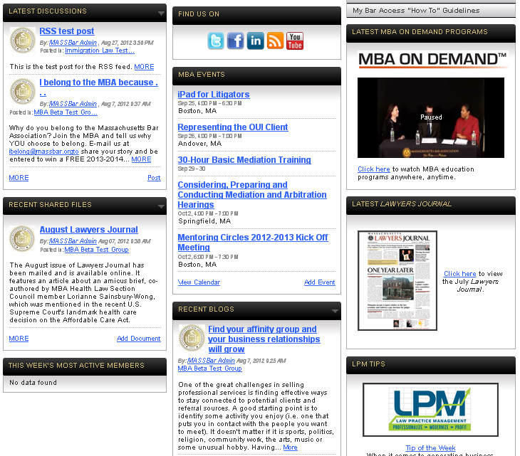
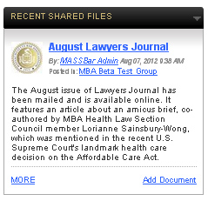
How to Access the Resource Library from Your My Bar Access Homepage
Header for content item
Options: Click to sort by most rated .
Title of recent shared file
Poster, date and time of post
Click the screen to find out about
recent shared files
Recent shared file text
Click to view previous recent shared files.
Click here to “add” a file to the resource library.
Return to the “How to Access the Resource Library” slide

Slide 46
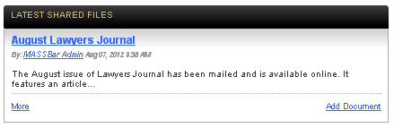
How to Access the Resource Library from Your Member Group’s Landing Page
The resource library can also be viewed and accessed from your member group’s landing page:
Dashboard
Header for
content item
Title of library entry
Poster, date and time of post
Click the screen to find out about
latest shared files
Library entry text
Click to view previous library entries.
Click to “add” a new file to the resource library.
Return to the “How to Access the Resource Library” slide

Slide 47
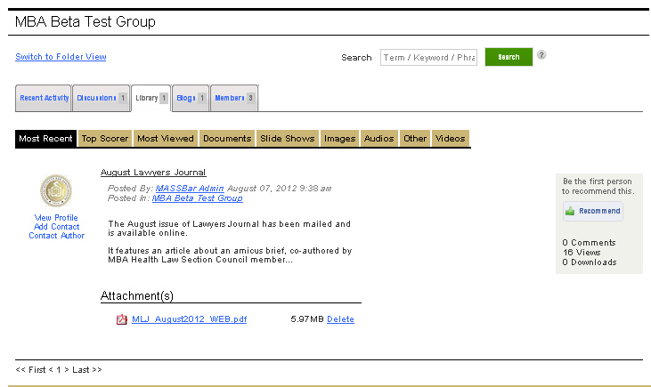
How to Access the Resource Library from Your Member Group’s Landing Page
The resource library can also be accessed by utilizing the dashboard of your member group’s landing page:
Toggle between “list” and “folder” view
Enter text to search library entries.
Dashboard
Sorting tabs for library entries
Profile information for the library contributor
Library entry
information
Click to “recommend” the library entry.
Library entry text
Attached file(s)
“delete” the library entry

Slide 48
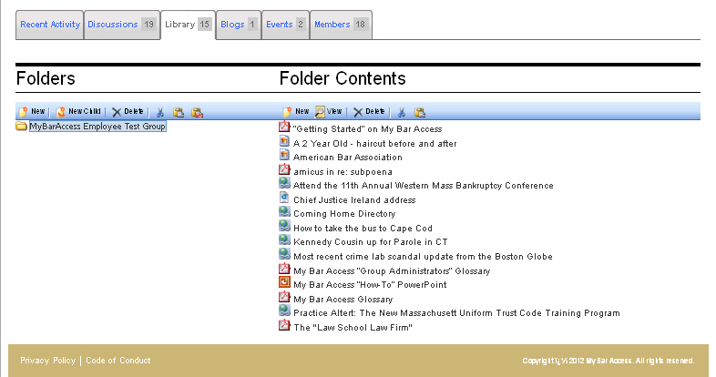
How to Add to the Resource Library
Clicking the “Switch to Folder View” link will navigate you to this screen:
Clicking the “Library” tab from your member group’s landing page will navigate you to this screen:
Click to create a “new” library entry
Click the “Switch to Folder View” link to navigate to the resource library entry screen.
Click the screen to continue
Return to the “How to Access the Resource Library” slide

Slide 49
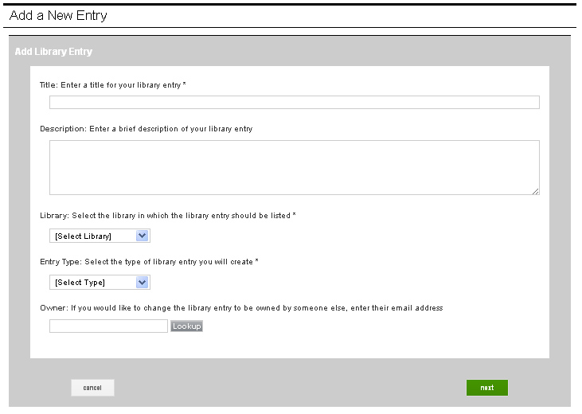
How to Add to the Resource Library
Clicking the “add document” link from either your My Bar Access homepage or your member group’s landing page, or by clicking the “new” link from the “Library” tab (as seen on the previous slide) will navigate you to the Add a New Entry screen:
Title for your library entry
Click the screen to find out how to add a file to the resource library
Insert a brief description of your library entry.
Select where you want your library entry to be listed.
Select the type of library entry you will create.
Enter an e-mail address to change ownership of the library entry.
Click to “cancel” your library entry.
Click the “next” button to proceed.

Slide 50
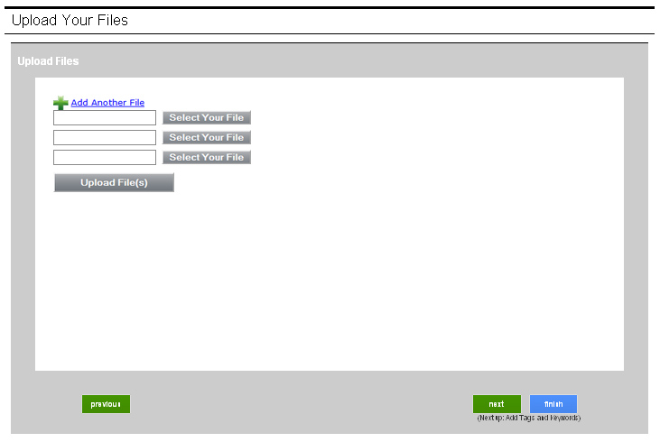
How to Add to the Resource Library
Clicking the “next” button will navigate you here:
Select file(s) to upload
Don’t forget to upload your file(s).
Click to navigate to the “previous” screen.
Click “finish” when you have completed adding files to the resource library.
Click the “next” button to add tags and keywords.

Slide 51
Visit My Bar Access today and connect, share and collaborate
access.massbar.org

